Slide 1
Value of DevOps

Slide 2

What’s driving DevOps?
Determine next set of investments based on learnings
Disconnects between Development and Operations increase mistakes and MTTR when issues occur
REQUIREMENTS
BACKLOG
Development
Production
Collaboration
The agile Methodologies are accelerating the construction process
Current ITLM/ITSM “best practices” made the release and operate processes reliable, but not agile

Slide 3
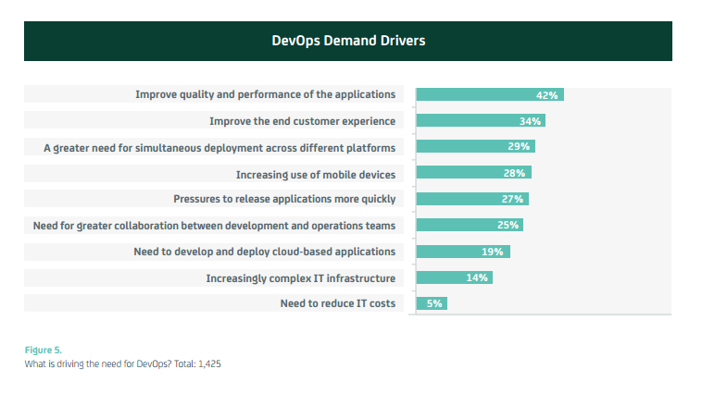
From:
Source: http://www.ca.com/content/dam/ca/us/files/white-paper/devops-winning-in-application-economy-2.pdf
Notes:
From: Dev Ops: The Worst-Kept Secret to Winning in the Application Economy (CA Technologies, 2014)

Slide 4
Value of DevOps
DevOps bridges the traditional divide allowing teams to produce high quality releases at increasing cadence
DevOps goals span the entire delivery pipeline

Slide 5
Shorter Cycles & Higher Quality
Faster time to market
Lower failure rates
Shortened lead time
Faster MTTR⁴
Mean Time To Realize, Recover, Repair, Remediate
Notes:
MTTR – Mean Time To Realize, Recover, Repair, Remediate

Slide 6
DevOps Report 2014
Companies with high-performing IT organizations are twice as likely to exceed their profitability, market share and productivity goals.
IT performance improves with DevOps maturity, and strongly correlates with well-known DevOps practices.
Culture matters. The cultural practices of DevOps are predictive of organizational performance.
Job satisfaction is the No. 1 predictor of performance against organizational goals.
https://puppetlabs.com/2014-devops-report

Slide 7
DevOps Report 2015
High-performing IT organizations experience 60X fewer failures and recover from failure 168X faster than their lower-performing peers. They also deploy 30X more frequently with 200X shorter lead times.
Lean management and continuous delivery practices create the conditions for delivering value faster, sustainably.
High performance is achievable no matter if your apps are greenfield, brownfield or legacy.
DevOps initiatives launched solely by C-level executives or from the grassroots are less likely to succeed.
IT managers play a critical role in promoting diversity and limiting burnout.
https://puppetlabs.com/2015-devops-report

Slide 8
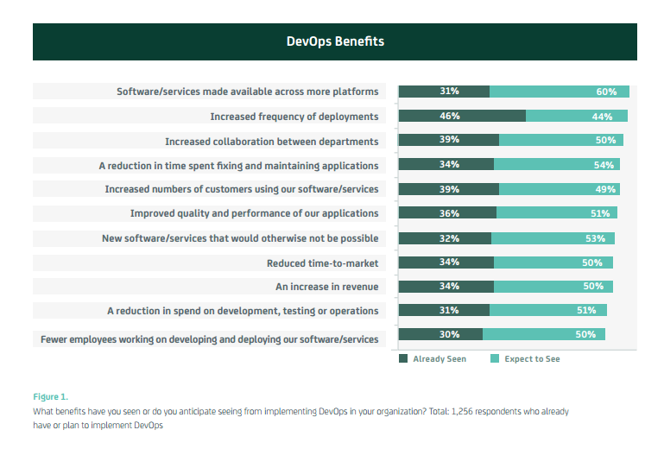
From:
Source: http://www.ca.com/content/dam/ca/us/files/white-paper/devops-winning-in-application-economy-2.pdf
Notes:
From: Dev Ops: The Worst-Kept Secret to Winning in the Application Economy (CA Technologies, 2014)

